Slide 1
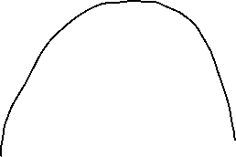
Pmax-o
Pmax-n
Δy
Pa
Pb
Xa
X = (Xa+Xb)/2
Xb

